Slide 1
HTML5 & Modular Design
12
I399 Web Development

Slide 2
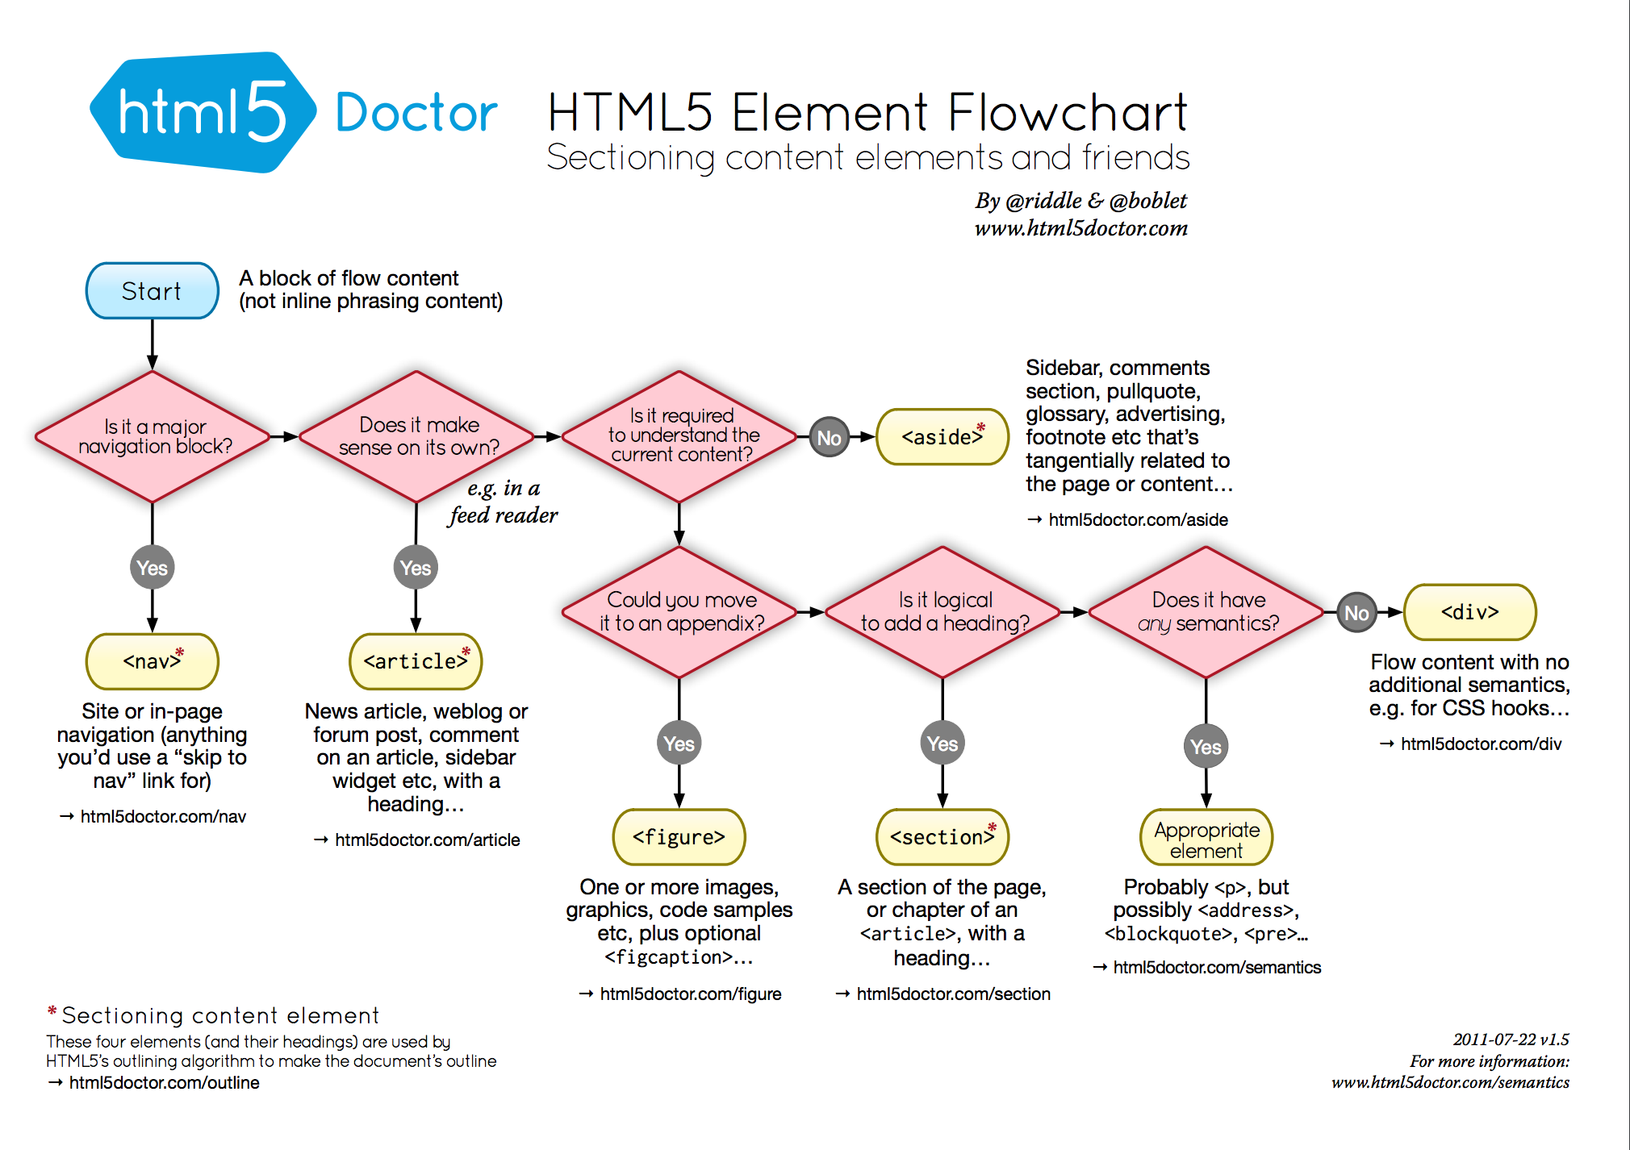

Slide 3
div .container
All elements on the page go into a <div> that serves as the container for the website.
The container keeps the main content for your site from stretching too wide and making the text unreadable.
.container {
width: 960px;
margin: 0 auto;
}
h1
OLD WAY
p
body

Slide 4
The page is divided into horizontal (usually) sections and content is contained within named containers. Modular design = better control.
Example:
<header>
<div id=”branding”>
<img src=”logo.jpg” alt=”logo>
<h1>Company</h1>
<h2>Tagline</h2>
</div>
</header>
#branding {
width: 960px;
margin: 0 auto;
}
header
MODULAR
#content {
width: 960px;
margin: 0 auto;
}
article
#sitemap {
width: 960px;
margin: 0 auto;
}
Describes the general type of content or purpose of the content.
footer
Describes the module’s purpose.
body

Slide 5
In HTML5, each module allows the heading structure to start over.
Good Each module can be coded separately.
Tricky We have to be more specific with our selectors, or the styles won’t look the way we intended.
In this example, even though we have separate <h1> for each title, they all appear blue because that is the last style in the list. The styles for red and green are overwritten in the CSS.
header
h1 {
color: red;
}
#branding
I’m an H1!
MODULAR
article
h1 {
color: green;
}
#content
So am I!
footer
h1 {
color: blue;
}
#sitemap
Me too!
body

Slide 6
Style content within a module by being more specific.
header h1 { ... }
This will style ALL <h1> elements within the module <header>.
If we had a need to be more specific than we could, for example, also add a class or id to the element we want to style.
Or, coming soon, we could perhaps use fancier selectors..
header
header h1 {
color: red;
}
#branding
I’m an H1!
MODULAR
article
article h1 {
color: green;
}
#content
So am I!
footer
footer h1 {
color: blue;
}
#sitemap
Me too!
body

Slide 7
What if you need more than one style for links?
a:link { text-decoration: none; color: red; }
nav a:link { display: block; padding: 10px 20px; background-color: blue; }
footer a:link { font-size: 10px; }
Modular design allows us to scope. This means we can create a style that is specific to a module.

